Slide 1



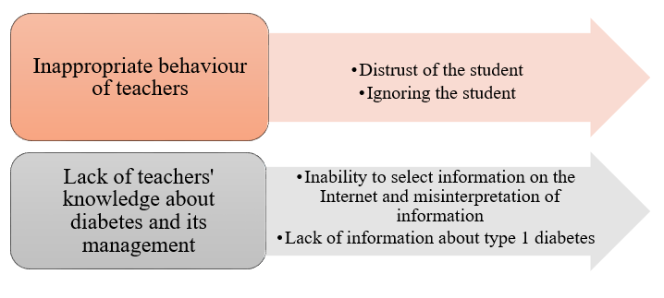
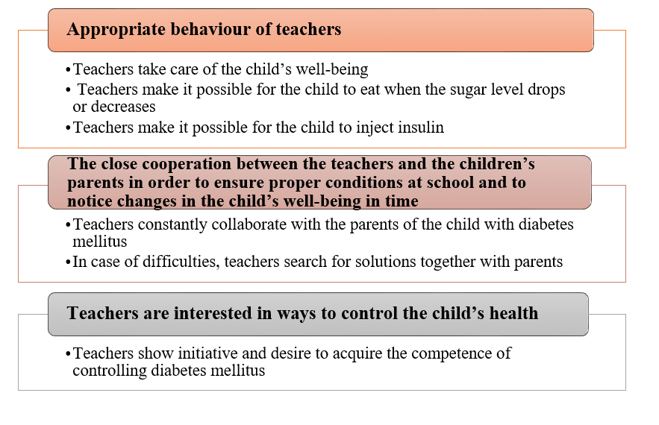
Development and Support of Health Competence at School: Experience of Children with Type 1 Diabetes Mellitus
PAPER ID 816
Indrė Čergelytė-Podgrušienė¹, Vida Gudžinskienė²
¹Vilnius University, Faculty of, medicine, Vilnius, Lithuania
²Mykolas Romeris University, Faculty of Human and Society studies, Vilnius, Lithuania
Introduction
Results:
Children with type 1 diabetes mellitus spend a large part of their time in the educational environment of the school, thus the development of health competence is inseparable from it.Diabetes educators, who are trained in how to deal with a child with diabetes mellitus, can help the child manage the disease in the school environment. Successful management of diabetes in school requires continuous cooperation and communication between the school community, parents, and health professionals/diabetes educators. Self-help meetings are very important in schools, as educators and teachers can learn to help the child manage the disease in the school environment and thus, contribute to the development of health competence.
The study shows that children with diabetes mellitus in developing and maintaining health competence, revealed five topics related to teachers (inappropriate behaviour of teachers; lack of teachers; knowledge about diabetes mellitus and its management; appropriate behaviour of teachers; the close cooperation between the teachers and the children’s parents in order to ensure proper conditions at school and to notice changes in the child’s well-being in time; teachers are interested in ways to control the child’s health (Fig.1)
Image content credentials generated using artificial intelligence
Fig.1. Experiences of children with diabetes mellitus at school
The aim of this research
Conclusions
Research aim is to reveal the opportunities for the development of health competence at school based on the experience of children with type I diabetes mellitus.
The research revealed that children do not consider school to be the environment for the development of health competence, and believe that school does not contribute to its development. The research found that children find the support and help of teachers and their educators important, but they do not receive help and support from teachers working in the educational institution, children feel unsafe, and the management of their disease worsens. The research also revealed that there are certain educational institutions where teachers try to help children with diabetes mellitus, help control their disease at school, provide necessary conditions to measure blood sugar and inject insulin when needed, closely work with both the child and one’s parents, thus contributing to the development and maintenance of health competence of a child with diabetes.
However, the research showed that some children with diabetes mellitus not only do not receive help from teachers in developing and maintaining health competence, but also face challenges related to inappropriate behaviour of the teacher towards the child. Firstly, the teachers do not understand what type 1 diabetes mellitus is and how it is managed, thus there are situations that are dangerous for the child’s condition: when teachers ignore the children’s needs to monitor insulin, when they do not believe if children say they need to withdraw from the activities immediately and control the disease. Secondly, teachers are not able to select appropriate information about the types of diabetes mellitus on the Internet, and the following makes it difficult for teachers to understand this chronic disease and they do not assess the child’s critical condition as serious or even life-threatening.
Research methods and subjects
Method of data collection. Qualitative research type was chosen for the study. The purpose of a qualitative study is to disclose experiences of children with diabetes, related to the acquisition of opportunities for development of health competence at school based on the experience of children with type 1 diabetes mellitus mellitus. The method of a semi-structured interview was used in the research for data collection; use of the content analysis method for the analysis of research data.
The sample of the research. The participants of the study were selected according to the following criteria: 1) children with diabetes mellitus; 2) children who suffer from diabetes from the age of 7 to the age of 15; 3) children who found out about the disease at least one year ago.
The study was conducted in August 2021. The duration of the interview was 120 minutes. 7 children with diabetes mellitus participated in the qualitative research. The age of research participants ranged from 8 to 15 years. There were 5 girls and 2 boys who participated in the research.
The obtained data were analysed by using the content analysis method. Qualitative content analysis was carried out in accordance with the inductive, study data based and categories composed logic.

